Slide 1
Well, we have to start somewhere.

Slide 2
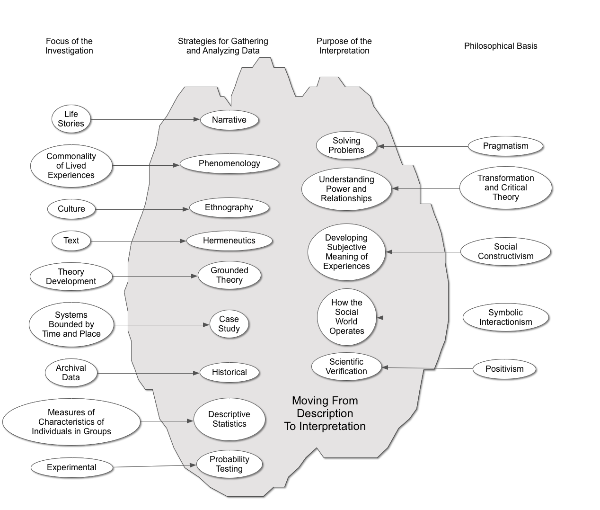

Slide 3
What is a philosophy?
The study of the theoretical basis of a particular branch of knowledge or experience.
A theory or attitude that acts as a guiding principle for behavior.

Slide 5
The purpose of philosophy?
Every philosophical position can be defined in terms of:
What is real
What is knowledge
What is beautiful or valuable
What is logical
From these comes the reasons for knowing what you want to know.

Slide 7
In your research where will you look for information?
Peoples stories
Observations
Text or artifacts
Archives
Measures of characteristics

Slide 9
How will you gather and analyze information?
Study methods
Every data collection approach requires a different set of procedures

Slide 11
How will you connect methods and purpose?
Although there are common ways that this is done, it is really up to the researcher to decide how best to answer the research question.
This turns into the conclusion section of your dissertation

Slide 13
Educational Research
Specific methods are applied to specific research tasks
That is the focus of this course
That is what that previous chart was about
Then you have to write a report on the research
Report writing is generally standardized
That is the remainder of this course

Slide 14
The Structure of Research Reports
What do you want to know?
Usually posed as why is it important to know this
What do others know already?
How will (did) you gather and analyze data?
Linking methods to the purpose
How were the data and analysis summarized?
What does it mean?

Slide 22
Research Proposal

Slide 24
Beginning to Think About Things to Study

Slide 25
Quantitative Research
Quantitative research is based on the collection and analysis of numerical data.
The data come from measuring characteristics of individuals in groups.

Slide 26
Quantitative Research
For studies in which groups will be compared statistically the general form of a quantitative question is:
What are the comparisons of characteristics of groups that differ by an intervention?
[group; characteristics to be compared; intervention]
The purpose of this study is to determine the impact of service learning on elementary student’s academic achievement.

Slide 27
Qualitative Research
Qualitative, interpretive research is useful for describing or answering questions about particular, localized occurrences or contexts and the perspectives of a particular group toward events, beliefs, or practices.

Slide 28
Qualitative Questions
The general form of qualitative questions is:
What are the patterns and perspectives of a group, about something, in a setting?
[group; setting; topic]
The purpose of this study is to examine how teachers in a single rural school district integrated service learning into the elementary curriculum?

Slide 29
Writing Purpose Statements
Write examples of your purpose statement.
Begin each statement with the phrase The purpose of this study is…
Identify the appropriate basic elements of each question.
Quantitative [group; characteristics to be compared; intervention]
Qualitative [group; setting; topic]
Discuss the following questions with your partner:
Is the question clear and understandable?
Are all of the necessary elements present?
Do the elements state what you want to know (is the question precise enough)?
When you listen to someone else’s question does it seem like a good research project—why or why not?

Slide 31
Doing a Literature Review
Step 1: Pin a poster of your purpose statement up over your computer.
Step 2: Make an outline based on the purpose statement. Nothing else.

Slide 32
Doing a Literature Review
Step 1: Pin a poster of your purpose statement up over your computer.
Step 2: Make an outline based on the problem statement. Nothing else.
Step 3: Go find literature.
Step 4: Write short reviews of everything you read. Ok, you will not do this but it is a good idea.
Step 5: Organize your chapter based on the outline.

Slide 33
Doing a Literature Review
Step 1: Pin a poster of your purpose statement up over your computer.
Step 2: Make an outline based on the problem statement. Nothing else.
Step 3: Go find literature.
Step 4: Write short reviews of everything you read. Ok, you won’t do this but it is a good idea.
Step 5: Organize your chapter based on the outline.

Slide 34
Literature Reviews
A literature review is a synthesis of the literature on a topic. To create the synthesis, one must first interpret and evaluate individual pieces of literature. Then, the ideas and information they contain must be integrated and restated in order to create a new, original written work. (p. 1)
Pan, M. L. (2004). Preparing literature reviews. (2nd ed.). Glendale, CA, Pyrczak Publishing.

Slide 35
Why Do Literature Reviews
You get really tired of listening to people say stuff that they are clearly making up.
A lit review is not a perfunctory assignment. It is a primary skill that all researchers must be able to apply in varying contexts for varying purposes—over and over again.

Slide 36
A Dissertation Literature Review
Demonstrate knowledge of the field
Justify the reason for the research
Establish a theoretical foundation
Establish a methodological rationale
Provide a basis for reflection on the importance of findings

Slide 37
What This Means
You are doing original research.
To demonstrate that it is original research you have to know everything that has been previously published on your topic.
During your dissertation defense, there is nothing worse than having someone ask about a piece of research that you have not read.
This is one of the many reasons that your research topic must be incredibly focused.

Slide 38
Primary vs. Secondary
A primary source is a report of research in which the author has gathered and analyzed data.
A secondary source is a report in which an author is reporting on other people’s primary research. (Like your lit review)
Be cautious of (but still use) secondary sources.
Books are often secondary sources.

Slide 39
What To Read
If what you are reading is not supported by other credible research then you probably should not be reading it.
Primary sources first.
Secondary sources if they are credible reviews of primary sources.
Other literature reviews
Meta-Analyses
Books are often secondary sources

Slide 40
Guiding Principle of Library Research
Library research is best done with a Guinness and a bag of Kettle’s Honey Dijon potato chips.

Slide 41
Meta-Analyses
Comparing effect sizes of multiple studies
Making inferences based on those comparisons
Lists all of the original studies that are included
Functions as primary research
Glass, G. V., McGaw, B., & Smith, M. L. (1981). Meta-analysis in social research. Beverly Hills, CA: Sage.

Slide 42
What Does Peer-Reviewed Mean?
You want to publish an article.
A peer is someone who either knows about your topic or knows how research should be done on your topic—preferably both.
Peer-reviewed means that your article is more credible because people who should know what they are talking about have said it is worthy.
Some journals are better at peer-review than others.

Slide 43
Reference List
Colley, K. M. (1999). Coming to know a school culture. (Unpublished doctoral dissertation). Virginia Polytechnic Institute and State University, Blacksburg, VA.
DeBruyne, J. W. (2001). A study to identify the factors responsible for job dissatisfaction and low teacher morale. Research paper. University of Wisconsin-Stout, Menomonie, WI.
Hinde, E. R. (2004). School culture and change: An examination of the effects of school culture on the process of change. Essays in Education, 12.
Jarzabkowski, L. M. (2002). The social dimensions of teacher collegiality. Journal of Educational Enquiry, 3(2), 1-20.
Mackenzie, N. (2007). Teacher morale: More complex than we think? Australian Educational Researcher, 34(1), 89-104.
Stolp, S. (1994). Leadership for school culture. ERIC Digest, 91, 1995-1991.

Slide 44
Finding Journals
Look in the reference list of ANY article related to your topic.

Slide 45
Finding Journals
Look in the reference list of ANY article related to your topic.
Use Summit
Go to library.up.edu (and bookmark the site)

Slide 46
Finding Journals—On the Library Page
Using “UP Library Search.”
Enter your search terms and type the word “periodicals” at the end.

Slide 47
Finding Journals
Look in the reference list of ANY article related to your topic.
Use Summit
Go to library.up.edu (and bookmark the site)
Look for journals that are likely to have extensive lit reviews

Slide 48
Using Published Literature Reviews
Handbook of Research on … (sorry, you probably have to go to the physical library)
American Educational Research Journal
Review of Educational Research
Journal of Educational Research
Dissertations

Slide 49
The Cautious Case for Books
Edited
Compilation of articles
Not necessarily peer reviewed
Single Author
Reviews of research (own and other’s)
Long publication cycle
Not necessarily peer reviewed
Text Books
Not necessarily peer reviewed

Slide 50
American Educational Research Association (AERA)
The largest educational research organization on the planet
The annual conference has 10 to 15 thousand participants
Think about the cycle of publication for researchers
www.aera.net

Slide 51
American Educational Research Association (AERA)
And, at long last…!
The Online Paper Repository
http://www.aera.net/Publications/tabid/10067/Default.aspx
A growingly complete repository for all of the papers presented

Slide 52
Google Scholar
WorldCat
Search results
Recent Articles
Direct Link
All versions
Citations
Related articles
UP resources

Slide 53
Reference Extractions
First and foremost
get good at typing references cold
Look for citation links
database services (EBSCO—not ERIC)
Google Scholar
RefWorks (owned by UP)
Commercial reference software (e.g., EndNote)
Zotero

Slide 54
How To Read
Read new to old
Read to determine if the article is relevant
Skim the reference list
Read for foundational studies
Read for findings
Read for the quality of the study
Carefully read complete articles that have risen to the top

Slide 55
How To Analyze
Develop rituals for tracking papers and notes
Distinguish between assertion and evidence
Identify patterns or trends across papers
Group writings into camps
Identify methodological strengths
Pay attention to how other authors have organized their lit reviews

Slide 56
How To Write
Know why you are writing the review
Outline your argument
Trace a path in your argument
Attach papers or camps to the path
Write in APA style
Describe the studies based on your outline looking for differences among studies
Account for outliers
Write a summary
Write a conclusion

Slide 57
Literature Reviews
Researchers write literature reviews. It is part of the job.
Keep yourself out of the lit review.
A reader should be able to trace every statement back to an author.
Try moving the citation as early in the sentence as possible.
In general, the best literature reviews are written by authors who start by knowing very little about the topics they are covering.

Slide 58
The deep neurological impact of cultural acquisition in brain development and the brain’s changes over time may be at least in part based on culture or tasks assigned (Park & Huang, 2010). Further, culture can attune people’s abilities and perceptions to reflect cultural expectations or interests (Freeman, Rule, & Ambady, 2009).
Park and Huang (2010) assert that the deep neurological impact of cultural acquisition in brain development and the brain’s changes over time may be at least in part based on culture or tasks assigned. In a 2009 study, Freeman, Rule, and Ambady found that culture can attune people’s abilities and perceptions to reflect cultural expectations or interests.

Slide 59
A Brief Word About Direct Quotations
Don’t
“Direct quotations are best avoided whenever possible. Using your own words by paraphrasing will better demonstrate your understanding and will allow you to emphasize the ways in which the ideas contribute to your paper’s main argument.” (Walden U. Online Writing Center)
Continuity, Smoothness, Economy, Clarity (Sections 3.05 – 3.09)

